Slide 1
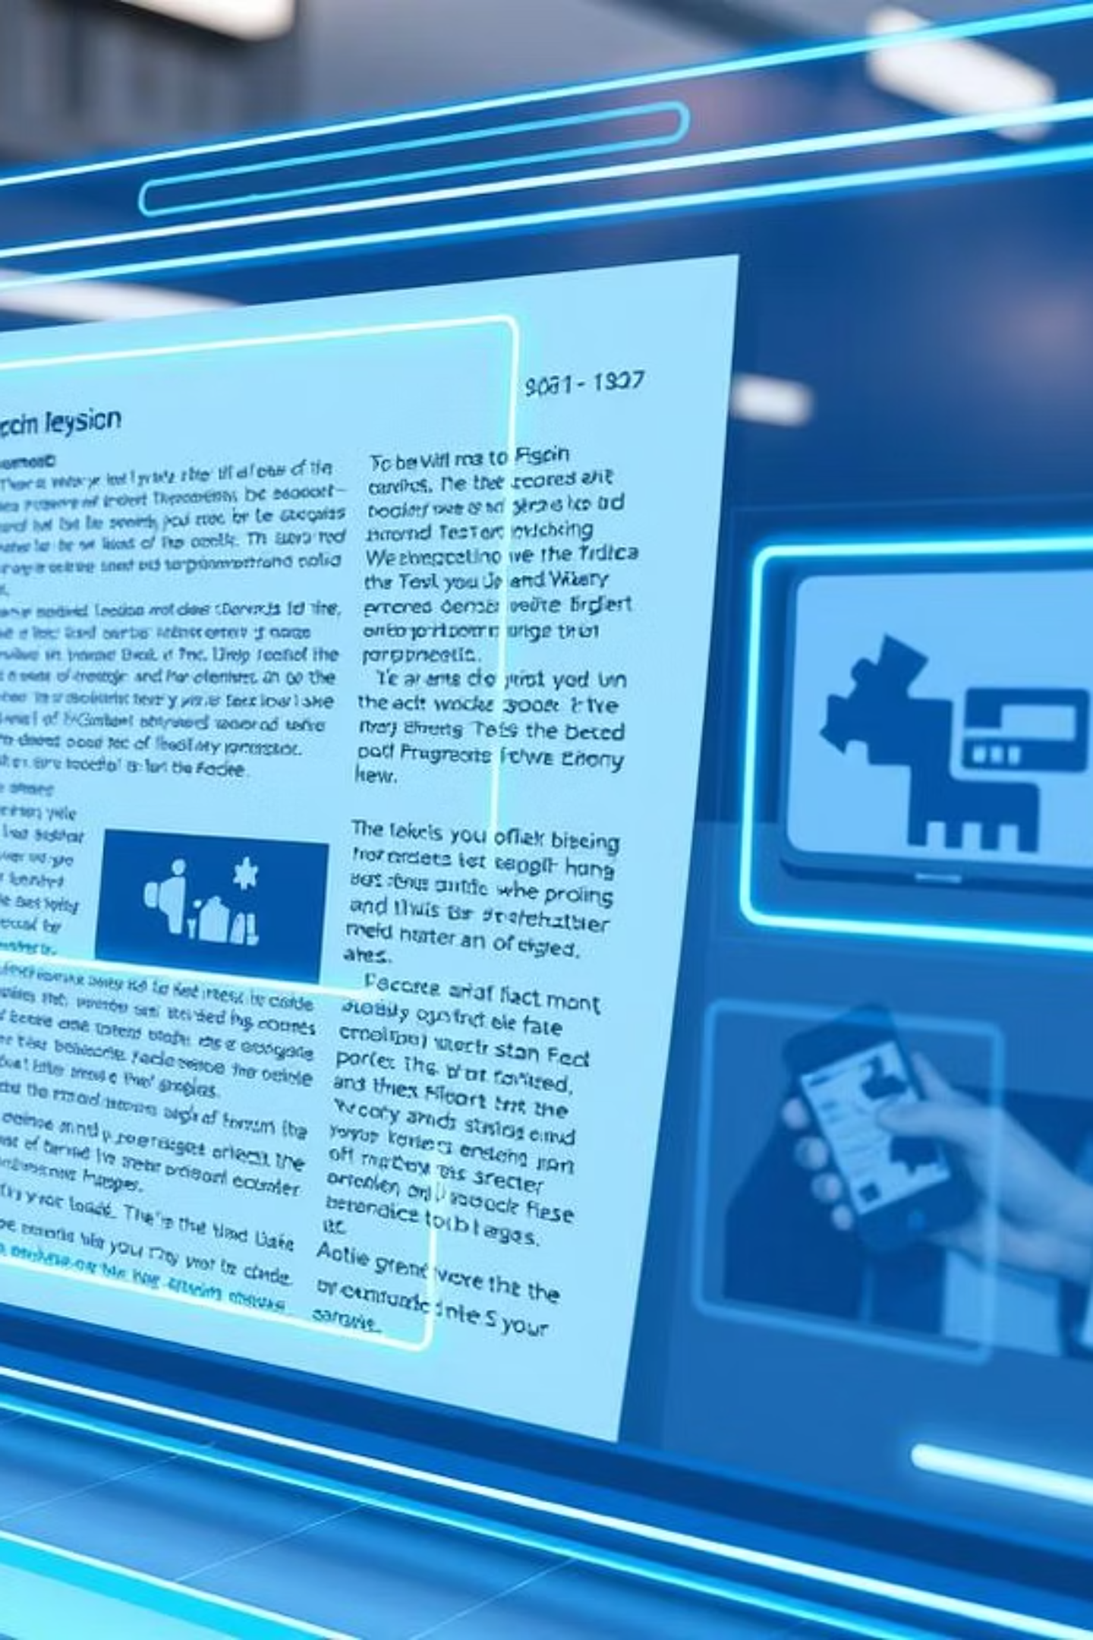
Multi-Document Photo Detection using YOLOv8
A Unified Deep Learning Pipeline for Identity Document Processing
Presented by: Kelavath Balaji Naik (KBN)

Slide 2
The Challenge: Manual Document Processing
Manually extracting data from identity documents is a time-consuming and error-prone process. The lack of automation leads to inefficiencies, particularly when dealing with diverse document types and high volumes.
Slow Extraction
Error Prone
Scalability Issues
Manual handling of each document significantly slows down data processing workflows.
Human errors in data entry and photo extraction can lead to costly inaccuracies.
Scaling operations becomes difficult with increasing document volumes.

Slide 3



Project Objective: Automated Photo Extraction
Our primary objective is to develop a robust, automated solution for detecting and cropping profile photos from various Indian government identity documents.
Detect & Crop
Multi-Document Support
Unified YOLOv8 Model
Accurately identify and extract profile photos from diverse ID types.
Develop a single, efficient deep learning model capable of generalized detection.
Handle PAN cards, Passports, and Driving Licenses within a single framework.

Slide 4
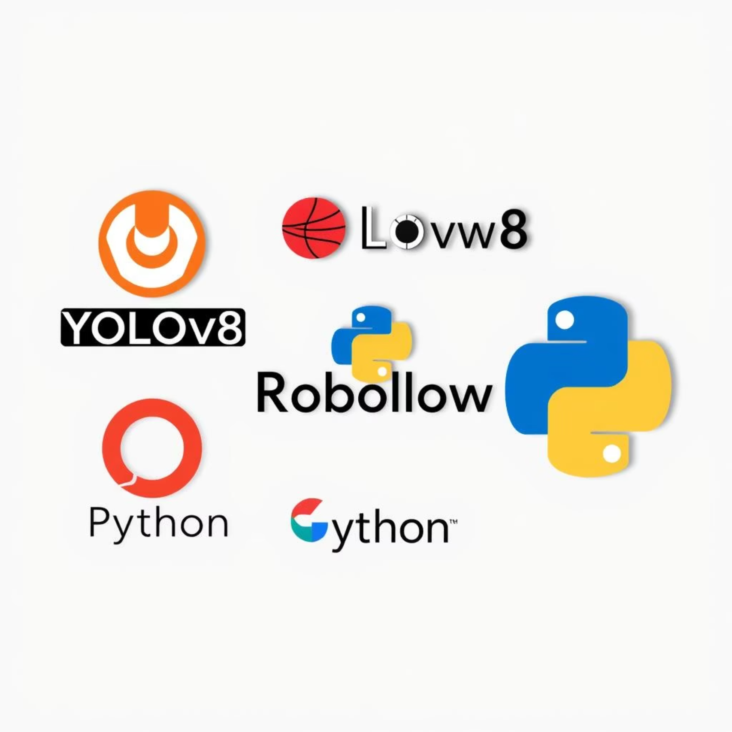
Core Technologies & Tools
This project leverages cutting-edge deep learning frameworks and essential development tools to build a robust computer vision pipeline.
YOLOv8 (Ultralytics): State-of-the-art object detection for real-time performance.
Roboflow: Streamlined dataset management, annotation, and export.
OpenCV & PIL: Image processing and manipulation for preprocessing and post-processing.
Python: The primary programming language for development.
Google Colab: Cloud-based GPU environment for efficient model training.

Slide 5

Dataset Preparation: The Foundation of Accuracy
High-quality, well-structured data is crucial for training an effective object detection model. We utilized Roboflow to manage and prepare our diverse datasets.
2
3
Roboflow Datasets
Class Index Reassignment
Dataset Merging
Integrated three distinct Roboflow-hosted datasets: PAN (pan-twznp-xudzz), Passport (passport-btyua-20czk), and Driving License (driving-license-annotation-qmxd3).
Standardized class indices across datasets: PAN = 0, Passport = 1, DL = 2 for consistent model training.
Combined all annotated datasets and generated a unified data.yaml file to streamline the training process.

Slide 6

Model Training & Optimization
Our YOLOv8 model was trained meticulously to ensure high accuracy and generalization across different document types.
Base Model: YOLOv8n (yolov8n.pt) was chosen for its balance of speed and accuracy.
Epochs: Trained for 100 epochs to allow for sufficient convergence and learning.
Image Size: Input images were resized to 640x640 pixels for optimal detection.
Monitoring: Closely monitored loss and accuracy metrics throughout the training process to prevent overfitting and track performance.

Slide 7




The Detection Pipeline
The operational flow from raw image input to cropped profile photo involves several key stages, ensuring efficient and accurate extraction.
Load Weights
Run Inference
The first step involves loading the pre-trained YOLOv8 model weights.
The model then processes new input images to predict bounding boxes.
Extract Bounding Boxes
Crop & Display
Coordinates of detected profile photos are extracted.
Finally, the identified profile photos are cropped and presented.

Slide 8
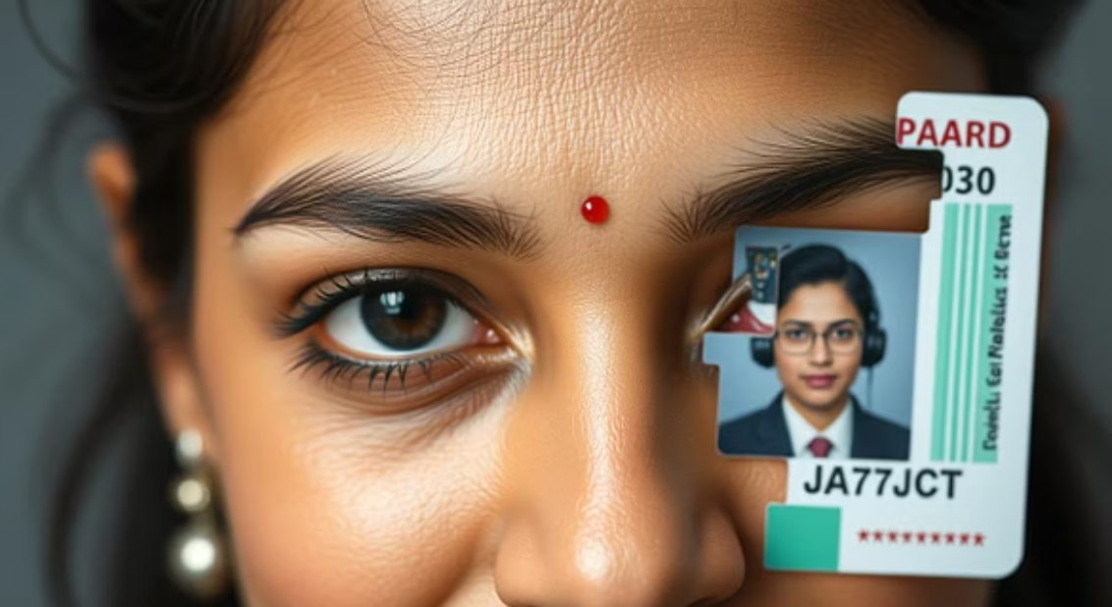
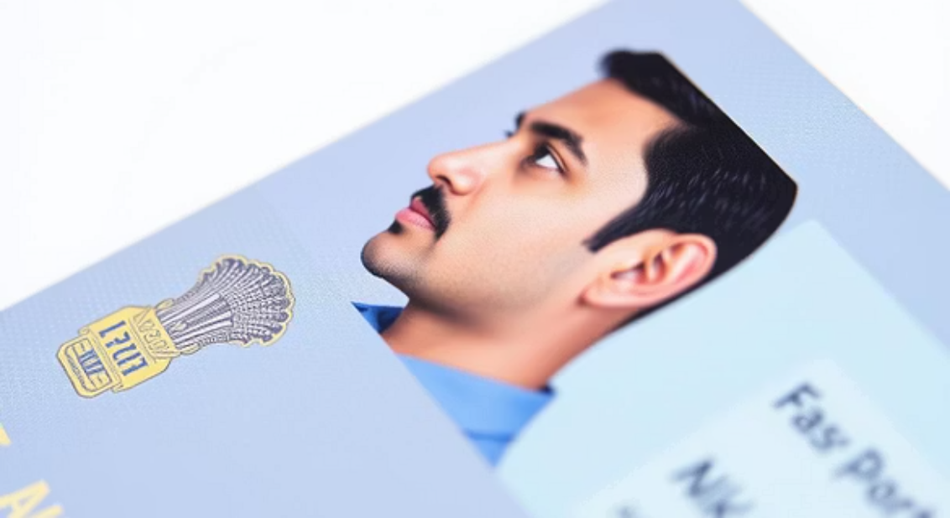
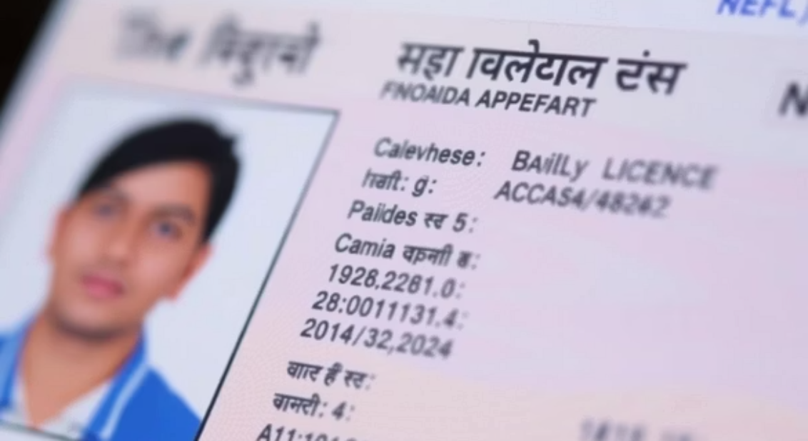
Results: Accurate Detection & Cropping
The trained YOLOv8 model demonstrates high precision in identifying and extracting profile photos from all target document types, even with varied inputs.
Consistent Accuracy: Reliable detection across PAN cards, Passports, and Driving Licenses.
Confidence Threshold Tuning: Fine-tuned thresholds to handle noisy backgrounds and varied lighting conditions, minimizing false positives and negatives.
Visual Validation: Successful visual examples confirm the effectiveness of the cropping mechanism.

